Slide 1
HEALTH, ILLNESS AND SOCIETY
By Dr. Frank Elwell

Slide 3
ACUTE DISEASES
DISEASES WITH FAIRLY QUICK, AND SOMETIMES DRAMATIC AND INCAPACITATING ONSET AND FROM WHICH A PERSON EITHER DIES OR RECOVERS.

Slide 4
CHRONIC DISEASES
PROGRESS OVER A LONG PERIOD OF TIME AND OFTEN EXIST LONG BEFORE THEY ARE DETECTED.

Slide 5
U.S. Death Rates per 100,000: 1900

Slide 6
U.S. Death Rates per 100,000: 1991

Slide 7
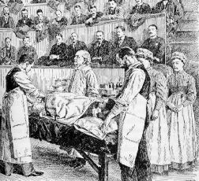
INDUSTRIAL SOCIETIES
WITH INDUSTRIALIZATION, THERE HAS BEEN A DRAMATIC INCREASE IN LIFE EXPECTANCY.

Slide 8
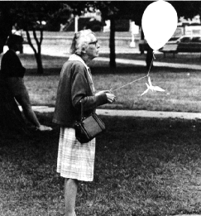
INDUSTRIAL SOCIETIES
TODAY, FOUR OUT OF THE FIVE LEADING CAUSES OF DEATH ARE CHRONIC DISEASES.

Slide 9
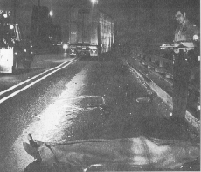
INDUSTRIAL SOCIETIES
THE FIFTH BEING ACCIDENTS.

Slide 10
CHRONIC DISEASE
ACUTE INFECTIOUS DISEASES HAVE BECOME RELATIVELY UNIMPORTANT IN TERMS OF MORTALITY, AND CHRONIC DISEASES CONFRONT SOCIETY WITH A DIFFERENT SET OF PROBLEMS.

Slide 11
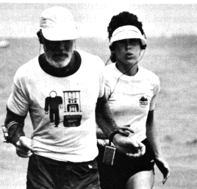
CHRONIC DISEASE
EFFECTIVE TREATMENT OF CHRONIC DISEASE CALLS FOR CONTINUAL RATHER THAN INTERMITTENT HEALTH CARE AND MAY REQUIRE THAT PEOPLE CHANGE THEIR LIFE-STYLES.

Slide 12
CHRONIC DISEASE
FURTHER, THE MOST EFFECTIVE AND LEAST EXPENSIVE WAY OF DEALING WITH MOST CHRONIC DISEASES IS PREVENTIVE MEDICINE, CHANGES IN LIFE-STYLE OR OTHER STEPS THAT HELP AVOID THE OCCURRENCE OF DISEASE.

Slide 13
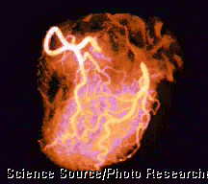
CRISIS MEDICINE
YET MODERN MEDICINE IS NOT ORGANIZED AROUND PREVENTION BUT RATHER TOWARD CURATIVE OR CRISIS MEDICINE: TREATING PEOPLE'S ILLNESS AFTER THEY BECOME ILL.

Slide 14
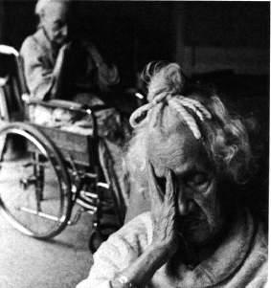
CRISIS MEDICINE
WITH CHRONIC DISEASES, HOWEVER, MUCH DAMAGE HAS ALREADY BEEN DONE--AND OFTEN CANNOT BE REVERSED--BY THE TIME SYMPTOMS MANIFEST THEMSELVES.

Slide 15
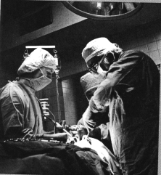
CRISIS MEDICINE
TO DATE, PREVENTIVE MEDICINE HAS HAD CONSIDERABLY LOWER PRIORITY IN TERMS OF RESEARCH AND PROGRAM FUNDING, AND THE ALLOCATION OF HEALTH CARE PERSONNEL.

Slide 16
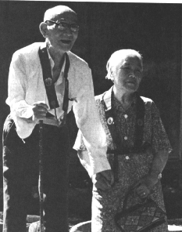
CRISIS MEDICINE
SO ONE OF THE MAJOR PROBLEM AREAS IN THE HEALTH-CARE SYSTEM TODAY IS THAT OUR HEALTH CARE ORGANIZATION HAS NOT ADAPTED TO THE CHANGING NATURE OF DISEASE.

Slide 17
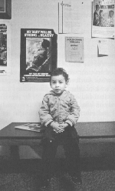
SOCIAL FACTORS IN ILLNESS
SOCIOECONOMIC STATUS (SES)
SEX
RACE
LIFE-STYLE FACTORS

Slide 18
SOCIOECONOMIC STATUS
THE EFFECT OF SES ON HEALTH IS VERY CLEAR: THOSE WHO ARE LOWER ON SUCH THINGS AS INCOME, EDUCATIONAL ACHIEVEMENT, AND OCCUPATIONAL STATUS HAVE SUBSTANTIALLY HIGHER DISEASE RATES AND DEATH RATES THAN DO THEIR MORE AFFLUENT COUNTERPARTS.

Slide 19
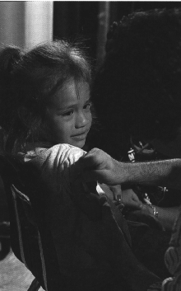
SOCIOECONOMIC STATUS
INCREASED SUSCEPTIBILITY TO DISEASE: THE POOR LIVE UNDER LESS SANITARY CONDITIONS, HAVE LESS NUTRITIOUS DIETS, AND ARE LESS LIKELY TO TAKE PREVENTIVE HEALTH ACTIONS.

Slide 20
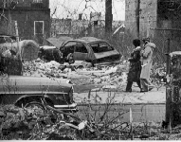
SOCIOECONOMIC STATUS
REGARDING INFANT MORTALITY, POOR WOMEN ARE LESS LIKELY TO HAVE PRENATAL CHECKUPS AND MORE LIKELY TO HAVE POOR DIETS THAT RESULT IN INFANTS WITH LOW BIRTH WEIGHTS.

Slide 21
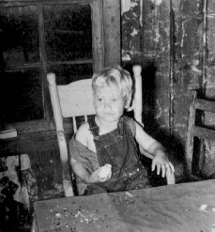
SOCIOECONOMIC STATUS
FINALLY THE MEDICAL CARE THAT THE POOR DO RECEIVE IS LIKELY TO BE OF LOWER QUALITY. NOT ALL ELIGIBLE FOR MEDICAID, STILL SOME OUT OF POCKET COSTS.

Slide 22
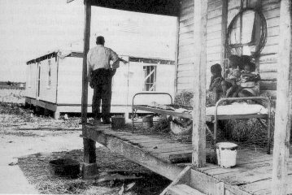
SOCIOECONOMIC STATUS
THEY ARE MORE LIKELY TO BE TREATED IN A HOSPITAL EMERGENCY ROOM WHERE CONTINUITY OF CARE, FOLLOW-UP TREATMENT, AND PATIENT EDUCATION ARE LESS COMMON THAN IN A PHYSICIAN'S OFFICE.

Slide 23
Infant Deaths per 100,000

Slide 24
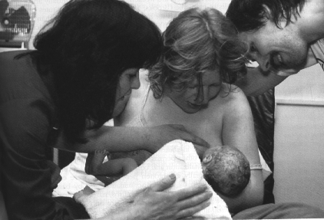
SEX
IF WE CONSIDER LONGEVITY AS THE KEY MEASURE OF HEALTH, WOMEN APPEAR TO BE HEALTHIER THAN MEN.

Slide 25
SEX
THE LIFE EXPECTANCY OF WOMEN TODAY IS SEVEN YEARS HIGHER THAN THAT OF MEN, COMPARED WITH ONLY THREE YEARS MORE AT THE TURN OF THE CENTURY.

Slide 26
Sex
WOMEN ALSO HAVE LOWER RATES OF MOST SERIOUS CHRONIC ILLNESSES. WHAT ACCOUNTS FOR THESE DIFFENCES?

Slide 27
SEX
FIRST, IT MAY WELL BE THAT WOMEN ARE BIOLOGICALLY MORE CAPABLE OF SURVIVAL THAN ARE MEN. MALES HAVE HIGHER DEATH RATES THAN FEMALES AT EVERY AGE, INCLUDING DEATHS OF FETUSES.

Slide 28
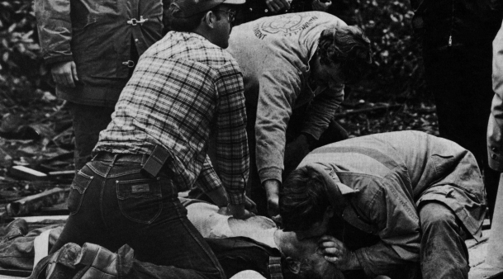
SEX
HIGHER MORTALITY RATES AMONG MALES IS ALSO DUE TO TRADITIONAL SEX-ROLE DEFINITIONS THAT ENCOURAGE MALES TO BE AGGRESSIVE AND TO SEEK MORE STRESSFUL AND DANGEROUS OCCUPATIONS.

Slide 29
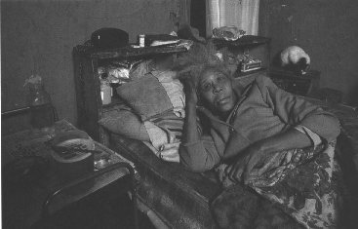
Sex
IN ADDITION, THE LIFE-STYLES OF AMERICAN MEN HAVE TRADITIONALLY BEEN LESS HEALTHY THAN THOSE OF WOMEN. THEY SMOKE MORE, DRINK MORE, EAT MORE.

Slide 30
Race
AFRICAN AMERICANS ARE AT A SERIOUS DISADVANTAGE WHEN IT COMES TO HEALTH, HAVING CONSIDERABLY HIGHER DEATH RATES, SHORTER LIFE EXPECTANCIES AND MORE LIFE-THREATENING HEALTH CONDITIONS.

Slide 31
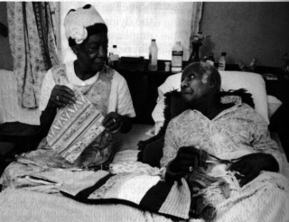
Race
ONE MAJOR REASON FOR THIS IS SES. YET EVEN WHEN SES IS CONTROLLED, SOME RACIAL DIFFERENCES PERSIST.

Slide 32
Race
ONE HYPOTHESIS IS THAT THE COMBINATION OF YEARS OF RACIAL OPPRESSION, POVERTY, AND PHYSICALLY DEMANDING OCCUPATIONS PROBABLY WORKS TO CAUSE ILLNESS.

Slide 33
Race
ALL OF THESE ARE RELATED TO STRESS, THIS STESS, IN TURN, PRODUCES GREATER SUSCEPTIBILITY TO DISEASE.

Slide 34
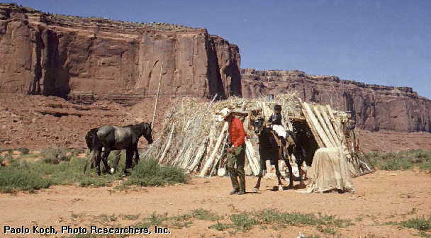
Race
NATIVE AMERICAN, ESPECIALLY THOSE ON RESERVATIONS, HAVE DISPROPORTIONATELY HIGH MORTALITY RATES.

Slide 35
Race
MUCH IS DUE TO HIGH RATES OF ACCIDENTS, SUICIDE, ALCOHOLISM CAUSED BY PROBLEMS OF POVERTY, UNEMPLOYMENT, AND CULTURAL DISINTEGRATION.

Slide 36
Life-style Factors
IT IS ESTIMATED THAT BETWEEN 70 AND 90% OF ALL HUMAN CANCERS ARE CAUSED IN PART BY ENVIRONMENTAL CONDITIONS, SUCH AS POLLUTION IN THE WATER, SOIL AND AIR.

Slide 37
Life-style Factors
INDUSTRIALIZATION HAS UNQUESTIONABLY IMPROVED OUR LIVES, BUT IT HAS ALSO CREATED HEALTH HAZARDS LARGELY UNKNOWN IN PREINDUSTRIAL SOCIETIES AND THAT CONTRIBUTE TO DEATH AND MISERY.

Slide 38
Life-style Factors
OCCUPATIONAL STRESS IS LINKED TO HEART DISEASE AND HYPERTENSION. UNEMPLOYMENT, OR EVEN THE THREAT OF IT, IS ASSOCIATED WITH MANY PHYSICAL AND MENTAL DISORDERS.

Slide 39
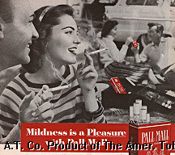
Life-style Factors
THE USE OF ALCOHOL, TOBACCO, AND OTHER DRUGS CAN ALSO CAUSE SERIOUS HEALTH PROBLEMS.

Slide 40
Life-style Factors
THERE EVEN APPEARS TO BE AN ASSOCIATION BETWEEN HEALTH AND THE QUALITY OF A PERSON'S FAMILY LIFE.

Slide 41
Life-style Factors
PEOPLE WHO ARE MARRIED AND HAVE CHILDREN ARE HEALTHIER THAN PEOPLE WHO ARE SINGLE AND HAVE NO CHILDREN.

Slide 42
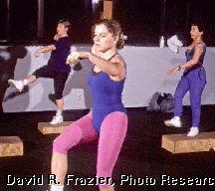
Life-style Factors
ANY OVERALL SOLUTION TO HEALTH PROBLEMS MUST TAKE INTO ACCOUNT THE WAYS IN WHICH PEOPLE'S LIVES CAN BE CHANGED TO IMPROVE THEIR HEALTH.

Slide 43
Life-style Factors
WE COULD GO ON AT LENGTH ON THIS TOPIC, BUT THE POINT SHOULD BE CLEAR: THERE ARE MANY ELEMENTS OF OUR LIFE-STYLE THAT ADVERSELY AFFECT OUR HEALTH.

Slide 44
Problems in the Health Care System:
RISING COSTS
A LACK OF ACCESS TO HEALTH CARE FOR MANY

Slide 45
Health Costs as % of GNP

Slide 46
Health Care Expenditures

Slide 47
Health Care Expenditures
PER CAPITA EXPENDITURES FOR HEALTH CARE HAVE INCREASED OVER 30 FOLD SINCE 1950.
WE NOW PAY OVER $5,000 EACH YEAR FOR HEALTH CARE GOODS AND SERVICES FOR EACH MAN, WOMAN, AND CHILD IN THE U.S.

Slide 48
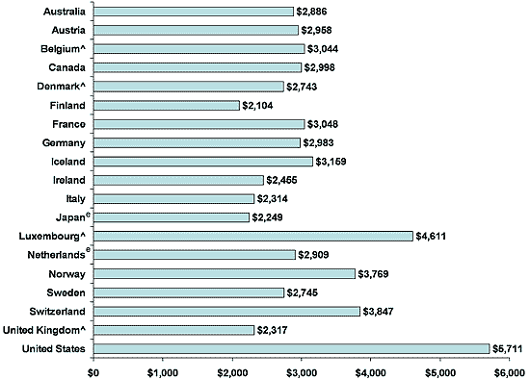
Per capita health care spending, 2003:

Slide 49
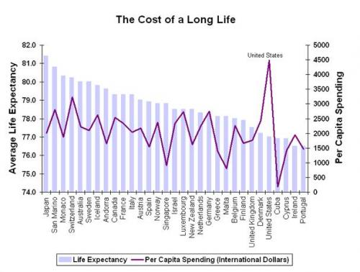

Slide 50
Cost of Health Care
It is astonishing that countries such as the U.K. and Denmark achieve a similar level of life expectancy with approximately half the cost compared to the U.S. And then there is Japan that has 4-5 more years in life expectancy for half the cost of the U.S. as well.

Slide 51
Health Care Expenditures
INFLATION ACCOUNTS FOR SOME OF THIS INCREASE, BUT INFLATION DURING THE SAME PERIOD INCREASED OVERALL PRICES ONLY ABOUT FOUR TIME.

Slide 52
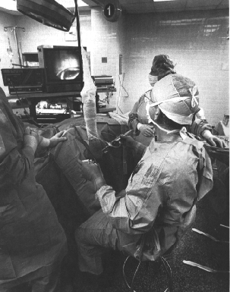
RISING COSTS: DEMAND
FIRST, OUR POPULATION IS LARGER, MORE AFFLUENT, AND OLDER, AND THESE FACTORS TEND TO INCREASE THE DEMAND FOR A FINITE AMOUNT OF HEALTH CARE GOODS AND SERVICES.

Slide 53
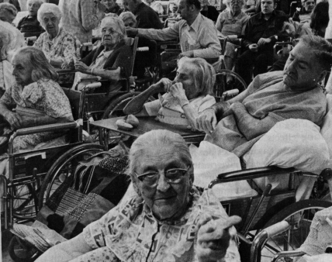
RISING COSTS: DEMAND
OLDER PEOPLE HAVE MORE HEALTH PROBLEMS AND REQUIRE MORE HEALTH-CAR SERVICES. AFFLUENT PEOPLE CAN AFFORD MORE AND BETTER HEALTH CARE.

Slide 54
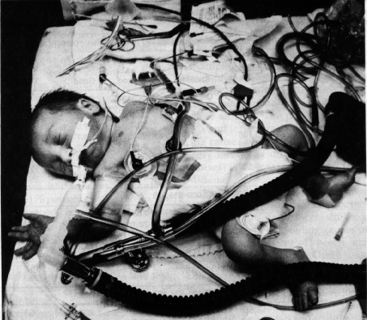
RISING COSTS: TECHNOLOGY
SECOND, IS THE AVAILABILITY OF DIAGNOSTIC AND TREATMENT PROCEDURES THAT WERE UNHEARD OF FIVE, TEN, OR TWENTY YEARS AGO.

Slide 55
RISING COSTS: TECHNOLOGY
THESE PROCEDURES CAN BE VERY COSTLY. PREMATURE BABIES WHO WOULD HAVE DIED TWO DECADES AGO ARE NOW SAVED IN EXPENSIVE NEONATAL INTENSIVE CARE UNITS (BUT AT A COST FROM $200,000 TO $1 MILLION FOR AN INFANT WHO WEIGHS ONLY ONE POUNT AT BIRTH).

Slide 56
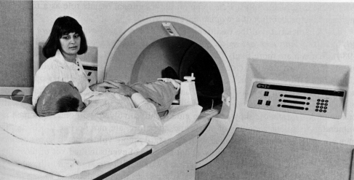
RISING COSTS: TECHNOLOGY
THE HEALTH CARE FINANCING ADMINISTRATION ESTIMATES THAT NEW TECHNOLOGIES ACCOUNT FOR 37% OF THE RECENT RISE IN HEALTH CARE COSTS.

Slide 57
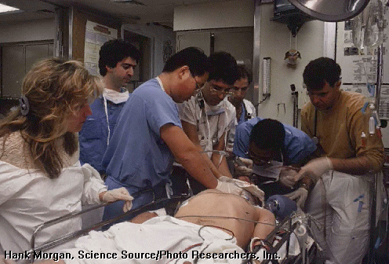
RISING COSTS: LABOR
THIRD, HEALTH CARE IS A LABOR INTENSIVE INDUSTRY--IT REQUIRES MANY PEOPLE TO PROVIDE HEALTH CARE--AND THE COST OF HEALTH CARE RISES WITH THEIR WAGES.

Slide 58
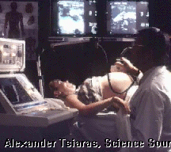
RISING COSTS: LABOR
ALSO, SAVINGS THROUGH AUTOMATION ARE NOT AS EASY TO ACHIEVE IN THE HEALTH FIELDS AS IN OTHER INDUSTRIES,

Slide 59
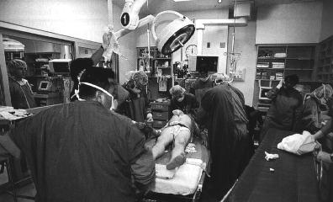
RISING COSTS: COMPETITION
FOURTH, ECONOMIC COMPETITION AND THE CHECK ON COSTS THAT THIS CAN AFFORD ARE WEAKER IN THE HEALTH FIELD THAN IN OTHER ECONOMIC AREAS.

Slide 60
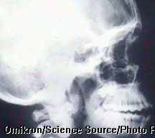
RISING COSTS: OVERUTILIZATION
FIFTH, THERE IS A TENDENCY TOWARD OVERUTILIZATION OF HEALTH-CARE SERVICES AND EVEN TO PERFORM UNNECESSARY DIAGNOSTIC AND TREATMENT PROCEDURES.

Slide 61
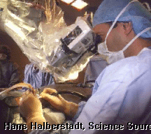
RISING COSTS: OVERUTILIZATION
THE SURGERY RATE IN THE UNITED STATES GREW MORE THAN TWICE AS FAST AS THE POPULATION BETWEEN 1979 AND 1987. BY ALL ACCOUNTS, TODAY IT IS THE HIGHEST IN THE WORLD.

Slide 62
RISING COSTS: OVERUTILIZATION
IN 1992 CONSUMER REPORTS PUBLISHED A STUDY CONCLUDEING THAT AS MUCH AS 20% OF ALL SURGERIES AND MEDICAL SERVICES PROVIDED IN THE U.S. ARE UNNECESSARY. WITH DEFENSIVE MEDICINE ON THE RISE, IT IS MUCH HIGHER TODAY.

Slide 63
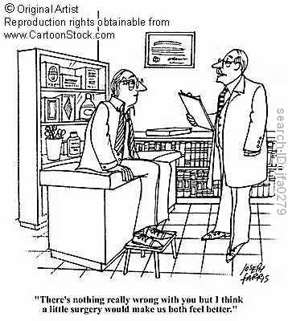
RISING COSTS: OVERUTILIZATION

Slide 64
RISING COSTS: INSURANCE
THE HEALTH INSURANCE INDUSTRY IS A PERHAPS THE MOST SIGNIFICANT FACTOR IN THE RECENT RISE OF COST OF HEALTH CARE IN AMERICA. HEALTH INSURANCE PROFITS OF THE 10 LARGEST INSURERS HAVE RISEN 428 PERCENT SINCE 2000.

Slide 65
RISING COSTS: INSURANCE
David Balto, former policy director of the Federal Trade Commission and now senior fellow at the Center for American Progress, writes: “Simply put, the private insurance companies have secured monopolies or tight oligopolies and exercised that power to put profits ahead of patients….”

Slide 66
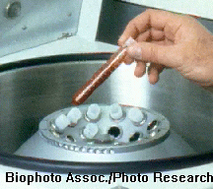
Health Care Expenditures
THERE ARE MANY POWERFUL INTEREST GROUPS BENEFITTING FROM RISING COSTS: PHYSICIANS, HOSPITALS, INSURANCE, THE PHARMACEUTICAL INDUSTRY, AND SO ON.

Slide 67
Health Care Expenditures
HEALTH-CARE CONSUMERS BENEFIT MOST FROM CONTROLLING COSTS, BUT THEY HAVE YET TO ORGANIZE INTO A POWERFUL LOBBY GROUP.

Slide 68
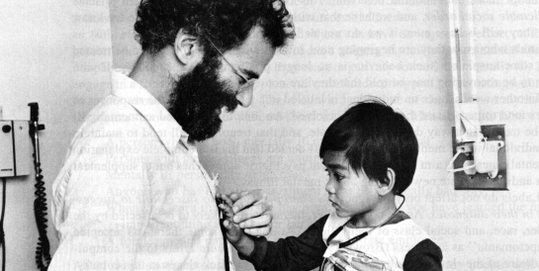
Access
WE HAVE SEEN HOW EXPENSIVE HEALTH CARE IS TODAY, WHICH MEANS THAT ONLY THE WEALTHIEST CAN PAY OUT OF THEIR OWN POCKET FOR MEDICAL SERVICES.

Slide 69
Access
MOST AMERICANS RELY ON HEALTH INSURANCE PROVIDED BY EMPLOYERS AS PART OF THEIR COMPENSATION FOR THEIR LABOR. HOW LONG CAN AMERICAN COMPANIES CONTINUE TO PAY EVER HIGHER RATES AND REMAIN COMPETITIVE IN THE GLOBAL ECONOMY?

Slide 70
Access
SINCE MEDICAID BECAME AVAILABLE IN THE 1960s, THE HEALTH CARE USE RATES AMONG THE POOR HAVE INCREASED. HOWEVER, CONSIDERABLY LESS THAN ONE-HALF OF THE POOR ARE ELIGIBLE FOR MEDICAID.

Slide 71
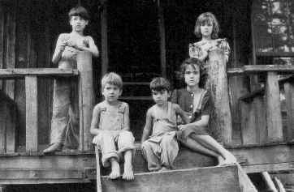
Access
AS A CONSEQUENCE, FULLY ONE-THIRD OF THE POOREST AMERICANS UNDER THE AGE OF 65 HAVE NO HELATH INSURANCE AT ALL, ACCESS TO MEDICAL CARE IS QUITE LIMITED.

Slide 72
Access
IN ADDITION TO THE POOR, THERE ARE OTHERS WHO FIND THEMSELVES WITHOUT HEALTH INSURANCE: LAID-OFF EMPLOYEES; PEOPLE WHO RETIRE BEFORE THEY ARE ELIGIBLE FOR MEDICARE; YOUNG PEOLE WHO ARE TOO OLD FOR COVERAGE UNDER THEIR PARENT'S PLAN, WIDOWS, WIDOWERS, AND DIVORCED PEOPLE WHO HAD DEPENDED ON THEIR SPOUSE'S HEALTH INSURANCE.

Slide 73
Access
ALL TOGETHER, ABOUT 47 MILLION AMERICANS, OR 20 PERCENT OF OUR POPULATION UNDER THE AGE OF 65, ARE WITHOUT HEALTH INSURANCE.

Slide 74
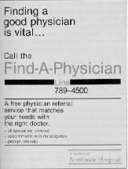
Access
ANOTHER DIMENSION OF ACCESS TO HEALTH CARE IS THE AVAILABILITY OF SERVICES.

Slide 75
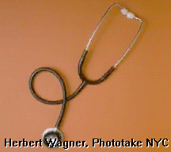
Access
IN THIS REGARD IT HAS BEEN RESIDENTS OF THE INNER CIY AND RURAL AREAS WHO ARE UNDERSERVED.

Slide 76
Access
PHYSICIANS PREFER TO PRACTICE IN LOCALS WHERE THEY WOULD LIKE TO LIVE AND CAN FIND A PROFITABLE CLIENTELE, AND NEITHER THE INNER CITY NOR RURAL AREAS CAN SATISFY THIS PREFERENCE.

Slide 77
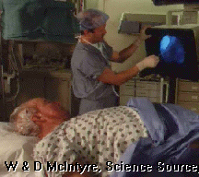
Access
ACCESS TO HEALTH CARE IS ALSO AFFECTED BY THE AVAILABILITY OF "PRIMARY CARE" PHSYICIANS WHO SERVE AS A PERSON'S FIRST CONTACT WITH THE SYSTEM.

Slide 78
Access
WHETHER FOR THE MONEY, OR THE DESIRE TO LEARN WELL A SMALL PART OF THE FIELD, PHYSICIANS OF THE PAST FEW DECADES HAVE OPTED FOR SPECIALTY TRAINING.

Slide 79
Access
PRIMARY CARE WAS A TASK PERFORMED BY GENERAL PRACTITIONERS IN THE PAST, BUT GPs ARE NOW ON THE DECLINE, WITH ONLY ABOUT 12% OF PHYSICIANS NOW ACTING AS GPs.

Slide 80
CONCLUSIONS
AMERICA BADLY NEEDS TO REFORM ITS HEALTH CARE SYSTEM. THE STRUGGLE IS NOT IN FINDING SOLUTIONS—MANY COUNTRIES HAVE ACCESS FOR ALL AND THEIR COSTS CONTROLED. THE PROBLEM IS PASSING REFORM OVER THE OBJEECTIONS OF POWERFUL GROUPS THAT BENEFIT FROM THE STATUS QUO.

