Slide 1
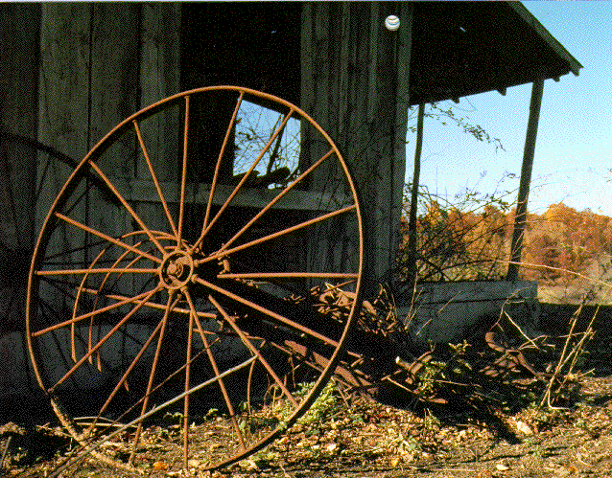
Industrial Agriculture
By Dr. Frank Elwell

Slide 2
Industrial Agriculture
This lecture is based partly on the work of Wendell Berry, the Kentucky conservationist who most fully illustrates the impact of industrialization on the natural environment, communities, and individuals in his 1977 book, The Unsettling of America.

Slide 3
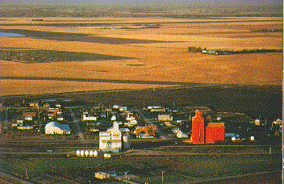
Industrial Agriculture
While the focus of this lecture is on agriculture, the industrialization of the American farm is but a part of the larger industrialization process, a process that has similar effects within other sectors of society.

Slide 4
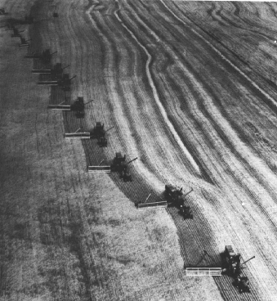
Industrial Agriculture
The industrialization (or intensification) of American agriculture has dramatically increased the productivity of the land but at the expense of depleting topsoil, water, and other natural resources.

Slide 5
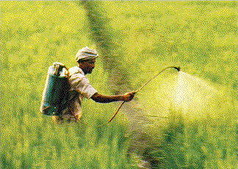
Industrial Agriculture
In order to increase production, farmers have relied on mechanization, chemical fertilizers, herbicides, fungicides, and pesticides--all of which pollute the environment and poison soil and underground water supplies.

Slide 6
Industrial Agriculture
"The so-called ‘green revolution’ is an oil revolution in which higher crop yields per acre have been made possible by continuous injections of fossil fuel energy into the production of plant varieties specially bred for their ability to respond to petrochemical inputs" (Harris, 1977: 284)

Slide 7
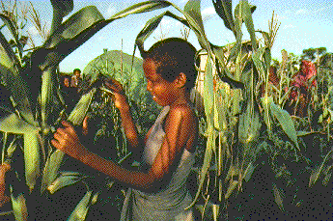
Intensification of Agriculture
Traditional agriculture used about 1 calorie of energy (usually in the form of human or animal labor) to produce 10 calories of food.

Slide 8
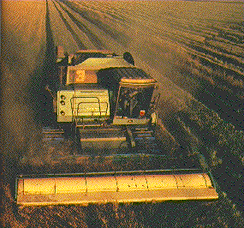
Intensification of Agriculture
With industrial agriculture, it takes 10 calories of energy (usually in the form of fossil fuels) to produce one calorie of food.

Slide 9
Intensification of Agriculture
David Pimental of Cornell University has shown that in the U.S. 2,790 calories of energy are now being used to produce and deliver one can of corn containing 270 calories of food.

Slide 10
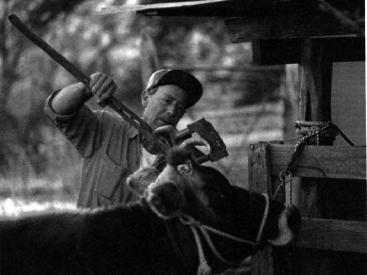
Intensification of Agriculture
The production of beef now requires even larger energy deficits: 22,000 calories to produce 100 grams of beef (containing the same 270 calories as in a can of corn).

Slide 11
Intensification of Agriculture
Berry calls this type of agriculture exploitive, an extractive industry in which maintenance and care of the land has given way to short-term production goals. Another name for it is the dominance of zweckrational, goal oriented behavior intended to maximize productivity, ignoring traditions, emotions, and values.

Slide 12
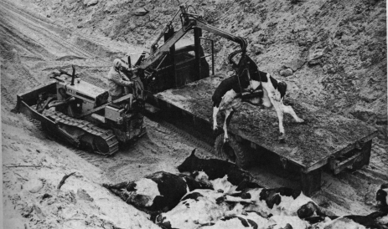
Intensification of Agriculture
This type of agriculture causes serious problems in the form of depletion of critical agricultural resources and pollution of the environment upon which agriculture is based.

Slide 13
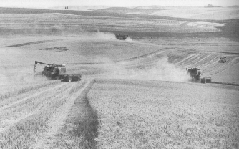
Intensification of Agriculture
Based on huge capital outlays this type of agriculture is sustainable only so long as supplies of oil remain plentiful.

Slide 14
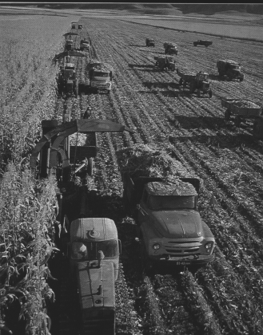
Bureaucratization
Along with the industrialization of agriculture has come the decline of farm families and communities.

Slide 15
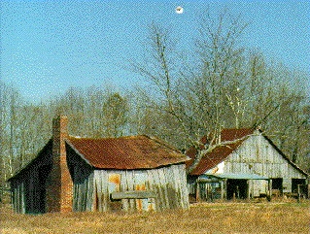
Bureaucratization
Based on huge capital outlays, this type of agriculture promotes the growing concentration of farmland in order to achieve economies of scale.

Slide 16
The Family Farm
Each year farm holdings have become larger, owners fewer.
Each year more and more small businesses that used to serve the family farm go under.
Each year former agricultural communities become a little poorer.

Slide 17
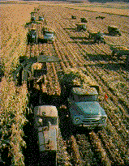
Corporate Farming
Berry contrasts the industrialization of American farms with the forced collectivization of peasants in the Soviet Union.

Slide 18
Corporate Farming
"I remember, during the fifties, the outrage with which our political leaders spoke of the forced removal of the populations of villages in communist countries...

Slide 19
Corporate Farming
"I also remember that at the same time, in Washington, the word on farming was 'Get big or get out'--a policy which is still in effect and which has taken an enormous toll...

Slide 20
Corporate Farming
"The only difference is that of method; the force used by the communists was military; with us, it has been economic--a 'free market' in which the freest were the richest" (Berry, 1977: 41).

Slide 21
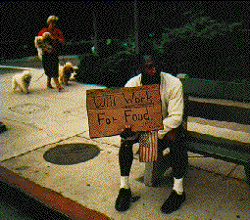
Corporate Farming
The people moved off the land often gravitate to large urban areas, many to become a permanent underclass, excluded from participation in modern society.

Slide 22
Corporate Farming
Many southern Blacks, for example, came north with the invention of the mechanical cotton picker in the 1920s and 30s.

Slide 23
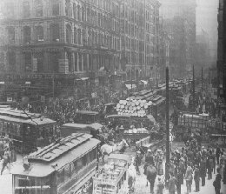
Corporate Farming
Industrial farming has not only destroyed rural communities, but has contributed to the disintegration of urban life as well.

Slide 24
Corporate Farming
Many of these people are steeped in outmoded rural tradition, unprepared for work in a bureaucratic industrial society. Nor do we have comparable jobs for them.

Slide 25
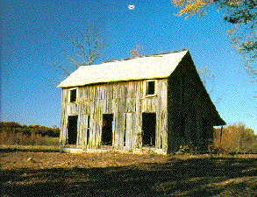
Concentration of Land
Between 1960 and 1974, the number of American farms decreased by 25%, while larger units went up by 80%.

Slide 26
Concentration of Land
Further, in 1971 only about 20% of the largest farms received about 80% of all farm income. This centralization of American agriculture has continued to the present day.

Slide 27
Feedback Loops
Berry argues that the intensification of American agriculture has been promoted by a collaboration of "agribusinessmen" within corporations, "agriscientists" within the universities, and bureaucrats within government agricultural agencies.

Slide 28
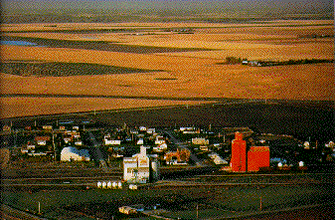
Feedback Loops
It is their interests their ambitions and goals that have determined the direction of agricultural development.

Slide 29
Role of Elites
As such, it has been the interests of merchants and industrialists, academic careerists and bureaucrats that have guided the industrialization of the farm (all of whom represent the interests of secondary organizations).

Slide 30
Role of Elites
It is industrialists, merchants and academic careerists who have truly benefited from modern agriculture, not the farmer who they are supposedly serving.

Slide 31
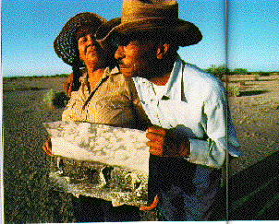
Rationalization
What Berry is condemning in modern agricultural bureaucracies is their obsessive focus on the narrow goal of productivity (zweckrational) to the exclusion of all other values (traditions and emotions).

Slide 32
Role of Elites
Bureaucrats "...who have promoted so-called efficiency at the expense of community (and real efficiency), and quantity at the expense of quality" (Berry, 1977: 42)

Slide 33
Rationalization
"Modern American agriculture has made itself a 'science' and has preserved itself within its grandiose and destructive assumptions by cutting itself off from the moral tradition (as it has done also from the agricultural tradition) and confining its vision and its thought within the bounds of internal accounting." --(Berry, 1977: 172).

Slide 34
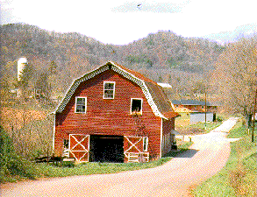
Bureaucracy and Rationalization
Like the goal-oriented behavior of other bureaucracies, the bureaucrats dominating agriculture ignore tradition and wider social values (care of the land and people) in their attempts to achieve their goal.

Slide 35
Rationalization/Specialization
Of the three bureaucracies promoting the intensification of agriculture, Berry heaps the most scorn upon agricultural professors. The increasing division of labor is part and parcel of industrialization and bureaucratization. Berry calls specialization the disease of the modern mind.

Slide 36
Rationalization/Specialization
"The careerist professor is by definition a specialist professor. Utterly dependent upon his institution, he blunts his critical intelligence and blurs his language so as to exist 'harmoniously' within it...

Slide 37
Rationalization/Specialization
...and so serves his school with an emasculated and fragmentary intelligence, deferring 'realistically' to the redundant procedures and meaningless demands of an inflated administrative bureaucracy whose educational purpose is written on its paychecks" (Berry, 1977: 148).

Slide 38
Rationalization/Specialization
The fragmentary intelligence is in reference to zweckrational--goal oriented thinking to the exclusion of all other considerations.
Deferring 'realistically' is Berry's slap at people who despair of changing the system, and so make the system stronger still.

Slide 39
Rationalization/Specialization
Finally the "inflated administrative bureaucracy" is a reference to bureaucratic growth that is far greater than necessary, with little relevance to the task it was supposed to reform (educational purpose written on its paychecks).

Slide 40
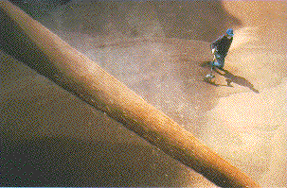
Rationalization/Specialization
The professors define agriculture in purely commercial terms. Their goal is to promote an agricultural system that provides food as efficiently as possible.

Slide 41
Rationalization/Specialization
As efficiently as possible means quickly, cheaply and with minimum human labor (no matter that people are being thrown out of work, losing their livelihoods), as well as to provide a market for agricultural machines and chemicals.

Slide 42
The Irrationality Factor
To advance in academe (or to make one's self marketable for lucrative jobs in the other agricultural bureaucracies), one's research must be oriented toward agribusiness, not the land or the farmers who work it.

Slide 43
The Irrationality Factor
The reason that Berry is so hostile to the academician is because the land grant college system was specifically instituted to promote the interests of the independent farmer (whom Jefferson believed to be the backbone of democracy).

Slide 44
The Irrationality Factor
Like experts in many bureaucracies, the academics defined their goal of serving the farmer in quantitative, measurable terms.
Productivity becomes the yardstick; values concerning the land, the welfare of the farming people themselves, rural communities, even the total society were simply not considered.

Slide 45
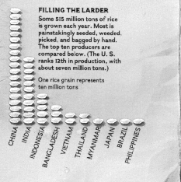
The Irrationality Factor
Focus on the single goal of productivity has caused some very irrational behavior on the part of agricultural bureaucracies.

Slide 46
The Irrationality Factor
The very people they were originally supposed to serve were thrown out of work, and even the professor's market for teaching has been severely reduced.

Slide 47
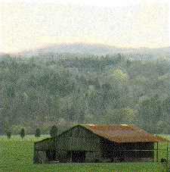
The Irrationality Factor
Partly as a result of their research, millions of farmers and farm workers have been forced from the land; the land itself is rapidly becoming depleted and polluted.

Slide 48
The Irrationality Factor
This research is often done at the behest of agribusiness which supplies lucrative grant monies, and of government, which is supposedly looking after the farmer.
To be a successful agriscientist, you go after the money. You do not focus on the people you are supposedly serving.

Slide 49
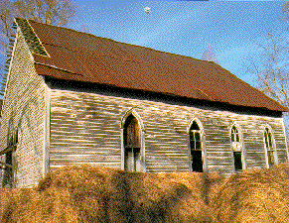
The Irrationality Factor
Consequently, bureaucracies originally set up to help farmers and farm communities actually pursue goals that end up destroying the very groups they are supposed to serve.

Slide 50
The Irrationality Factor
Berry describes the general process of irrationality of zweckrational in words that strongly echo Weber:
"The practical, divorced from the disciplines of value, tend to be defined by the immediate interests of the practitioner, and so becomes destructive of value, practical and otherwise" (Berry, 1977: 158)

Slide 51
Rationalization and the Individual
Berry also perceives the corrosive effects of excessive zweckrational experienced outside the bureaucracies of agriculture--that is on the farmer himself.

Slide 52
Rationalization and the Individual
"The concentration of the farmland into larger and larger holdings and fewer hands--with the consequent increase of overhead, debt, and dependence on machines--is a matter of complex significance...

Slide 53
Rationalization and the Individual
"It forces a profound revolution in the farmer's mind: once his investment in land and machines is large enough, he must forsake the values of husbandry and assume those of finance and technology."

Slide 54
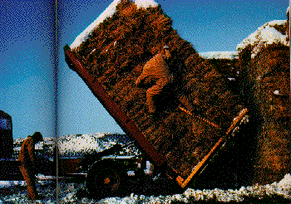
Rationalization and the Individual
Then his thinking is not determined by agricultural responsibility, love and care for the land, but of financial accountability and the capacities of machines.

Slide 55
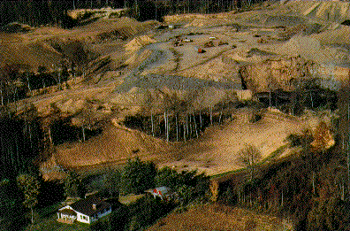
Rationalization and the Individual
"The economy of money has infiltrated and subverted the economies of nature, energy, and the human spirit" (Berry, 1977: pp. 45-46)

Slide 56
Rationalization and the Individual
The farmer is caught up in the drift of energy and interest away form the land community,and product and toward profit and productivity.

Slide 57
Rationalization and Alienation
A society that defines immediate productivity and efficiency as ultimate value, that judges all by these standards, cannot "afford" concern for tradition, environment, or wider social concerns.

Slide 58
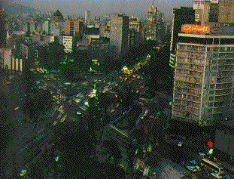
Rationalization and Alienation
The removal of human values from our work, an activity that defines our very humanity, affects all areas of our lives.

Slide 59
Rationalization and Alienation
It leaves us cut off from our past, cut off from wider moral and social values, cut off from our humanity itself. A condition long known as alienation.

Slide 60
Rationalization and Alienation
"It is impossible to mechanize production without mechanizing consumption, impossible to make machines of soil, plants, and animals without making machines also of people" (Berry, 1977: 75).

Slide 61
Rationalization and Alienation
"If human values are removed from production, how can they be preserved in consumption? How can we value our lives if we devalue them in making a living" (Berry, 1977: 79).

Slide 62
Rationalization and Alienation
Modern bureaucracies, modern thought (zweckrational), promote continued intensification, implying infinite industrial growth and consumption.

Slide 63
Traditions, Emotions and Values
But considering wider cultural values and traditions leads one to restraint.
These wider concerns, however, are not given voice in our bureaucracies, are not given value in our culture.

Slide 64
